Slide 1
Docker – A containerization technology
Bao Huynh
Junior Cloud Native Developer - Endava Vietnam
Founder / Head Lab - ITea Lab
1

Slide 2
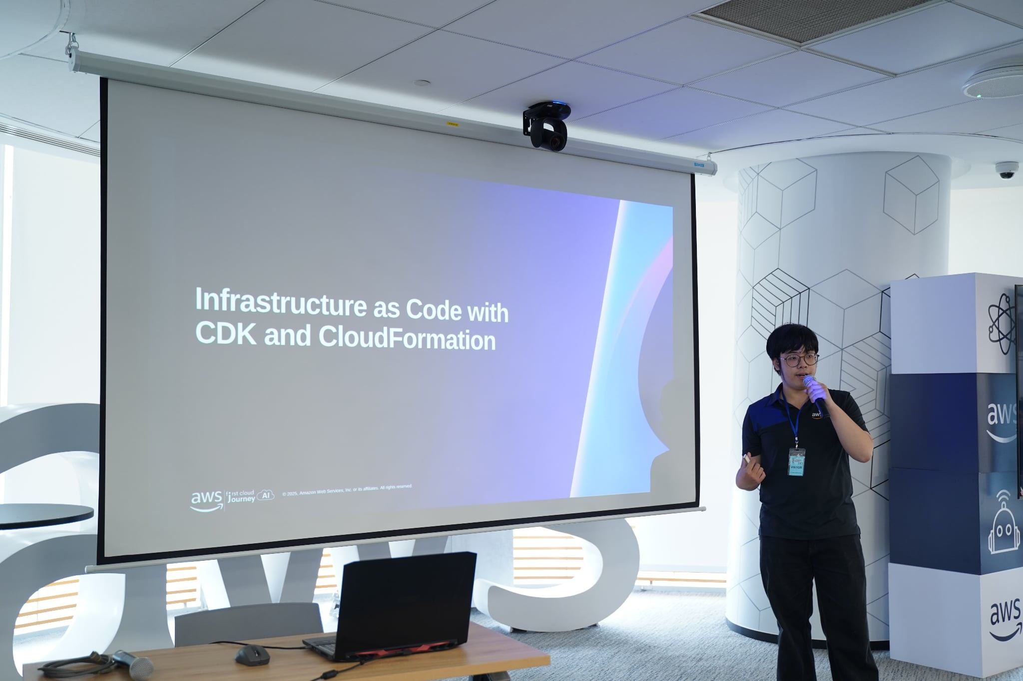
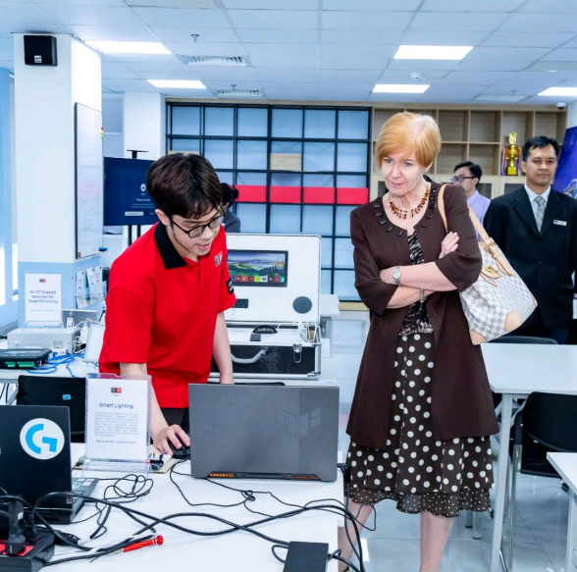

About me
Swinburne alumnus with a background in Computer Science
Cloud Native Developer at Endava Vietnam
Former Cloud DevOps Engineer at NAB Innovation Centre Vietnam
FCJ-er since 2025
Founder and Head of ITea Lab
A big fan of Vocaloid, Anime, Games, Music and Payday ==))))
2

Slide 3
Agenda
Virtualization
Containerization
Comparison: Virtualization vs Containerization
Docker introduction
Demonstration
3

Slide 4

Disclaimer
This is a friendly Docker intro, not a full course.
I may make mistakes, so feel free to correct me.
Let’s keep it relaxed, fun, and interactive.
Don’t be afraid to try Docker yourself!
4

Slide 5
Virtualization
5

Slide 6
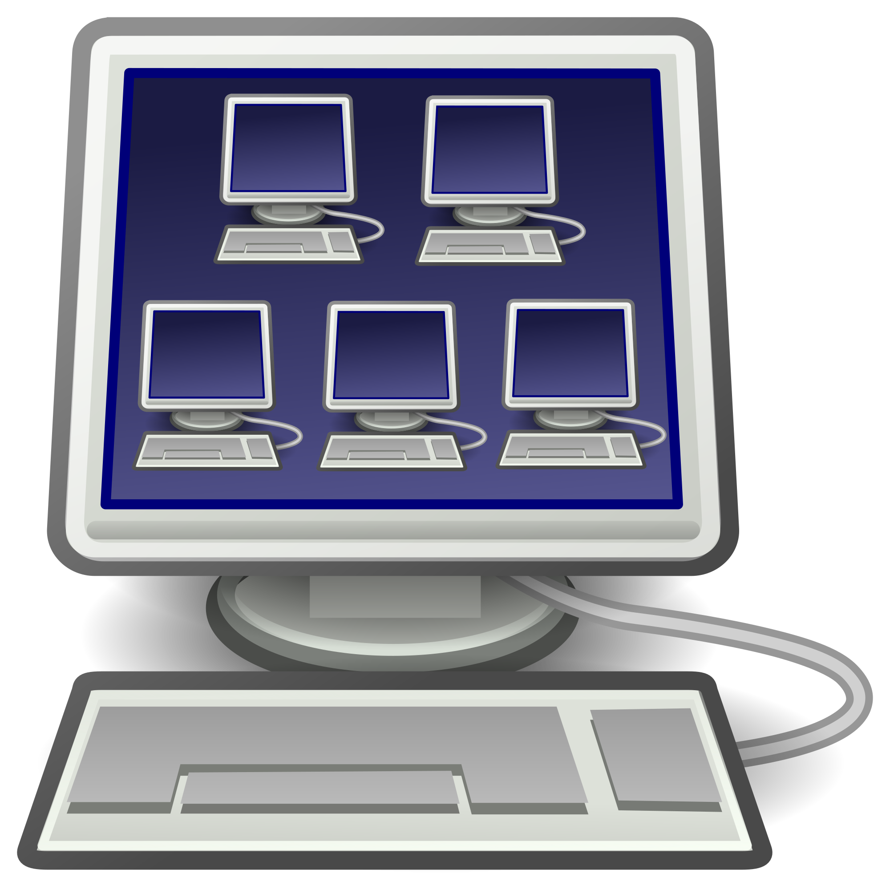
What is Virtualization?
6

Slide 7
Benefits of virtualization
Isolation
Keeps crashes separate
Keeps speed stable
Keeps apps separate
Encapsulation
Save state
Make copies
Portability
Runs on many machines.
7

Slide 8

Virtual machine problems
Each VM has its own OS
Uses more CPU, memory, and storage
Each VM needs updates
Too heavy for small apps
8

Slide 9
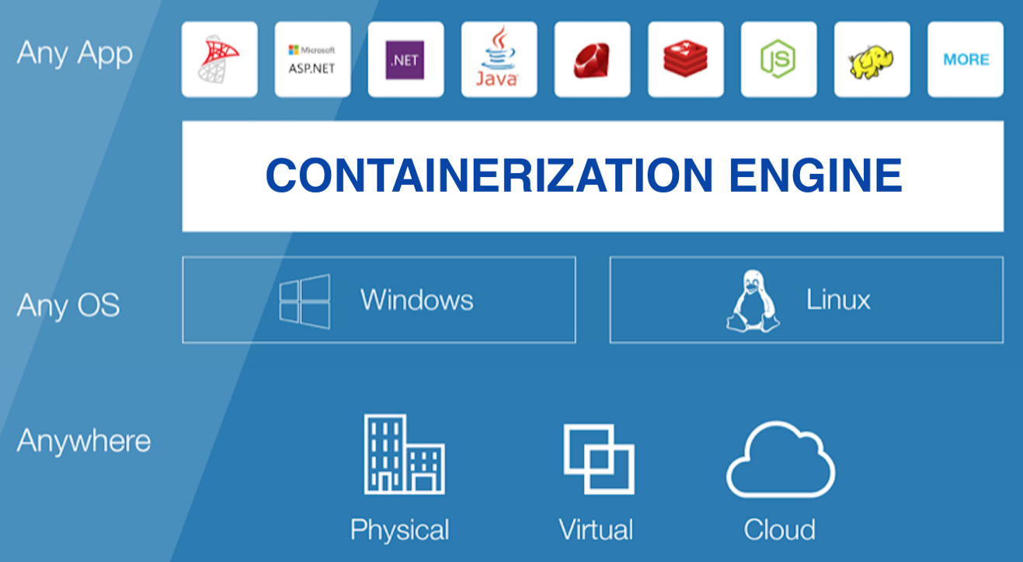
Containerization
9

Slide 10
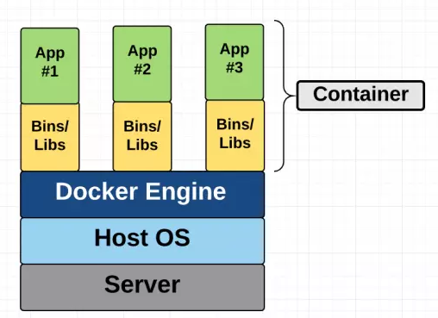
Containerization
Containerization means putting an app and everything it needs into one package, so it works the same everywhere.
10
Notes:
“Before containers, apps often had problems when moving from one computer to another. An app might work on my laptop, but fail on another machine because something is missing or different. Containers solve this by packing the app together with the things it needs.”
Diagram: “In the diagram, each green box is an app. The yellow part is the app’s needed files and libraries. Together, they make one container.”

Slide 11
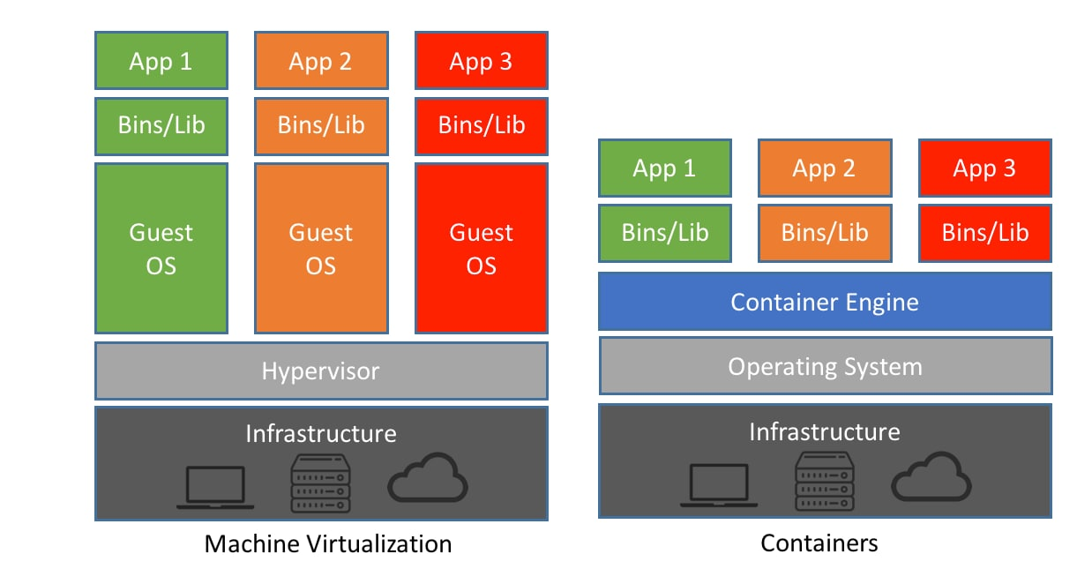
Compare with Virtual Machines
Containers are more lightweight than traditional Machine Virtualization
11

Slide 12
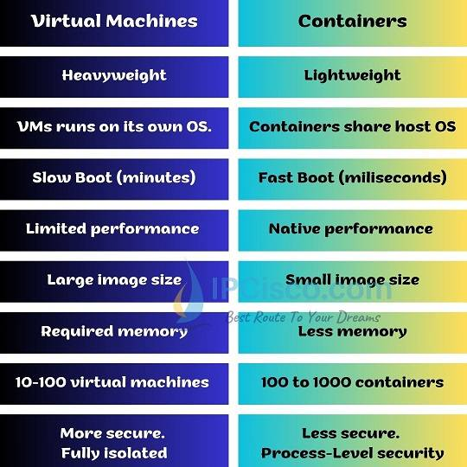
VM vs Container
12

Slide 13
Benefit of containerization
Portability
Consistency
Resource efficiency
Easily moved
Single container
Deploy across multiple environments
Runs consistently
No compatibility issues
Contain necessary dependencies and configurations
Lightweight
Consumes fewer resources
Ideal for running multiple applications on a single host
13

Slide 14
Docker
14

Slide 15
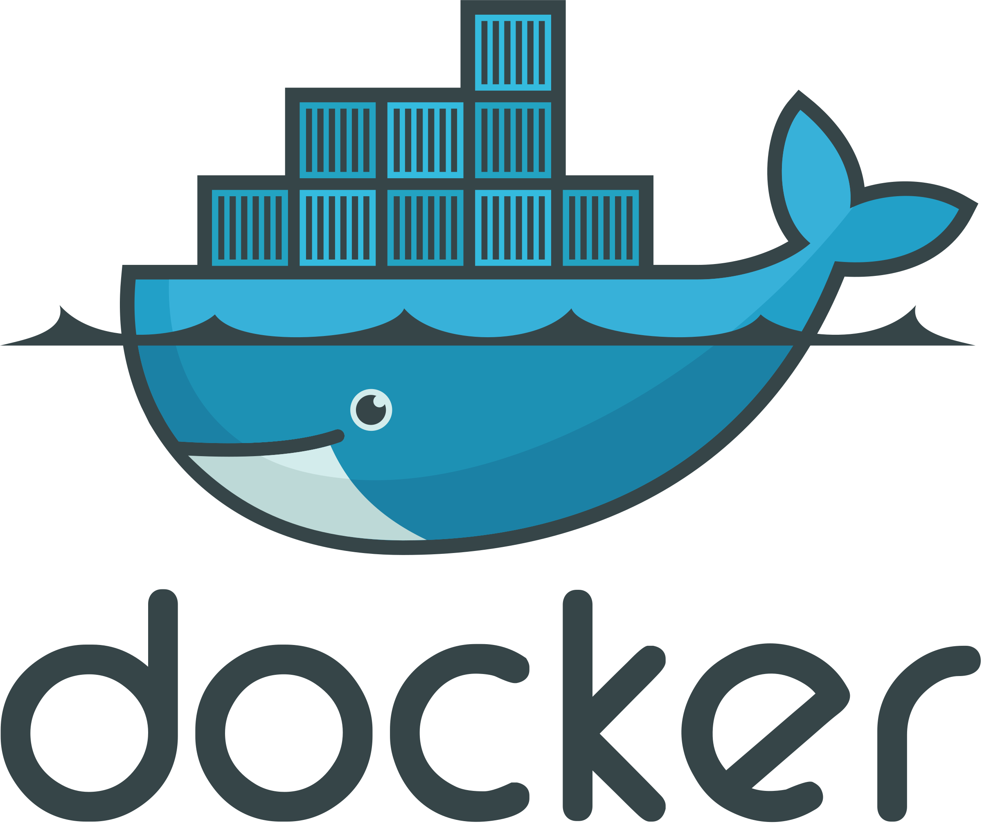
What is Docker?
Docker packages your app with everything it needs.
The app can run the same way on different machines.
Simple idea: build once, run anywhere.
15

Slide 16
Key Benefits of Docker
Faster development and deployment
More reliable and easier to scale
Deploy anywhere more easily
Lower infrastructure costs
16

Slide 17
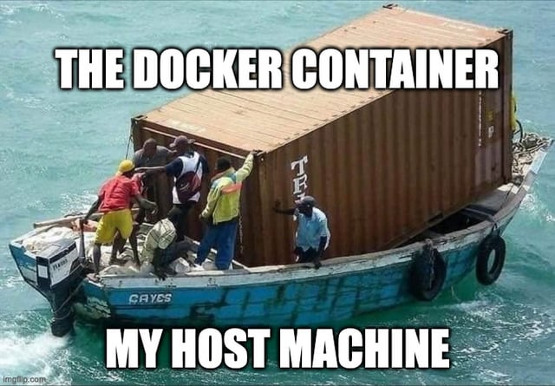
Docker Containers
Containers are apps running in Docker
They are created from Docker images
They run separately from your computer
You control them with Docker commands
17

Slide 18
Docker Images
Read-only templates that contain everything needed to run an application
Created from a Dockerfile, which specifies the application and its dependencies
Can be shared and reused across different environments
18

Slide 19
FROM ubuntu
ARG package=python3
RUN apt-get update \
&& apt-get install -y ${package}
WORKDIR /myapp
ADD/COPY myapp.py .
CMD/ENTRYPOINT [“python3”, “./myapp.py”]
Dockerfile
Example
19

Slide 20
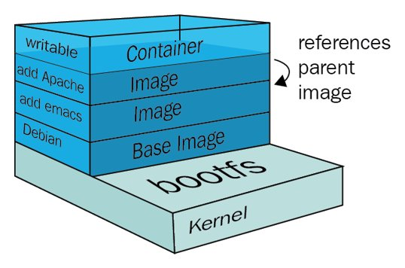
Docker Containers
Each Dockerfile instruction creates an image layer.
During builds, Docker reuses unchanged layers from cache.
When a layer changes, Docker rebuilds that layer and everything after it.
20

Slide 21
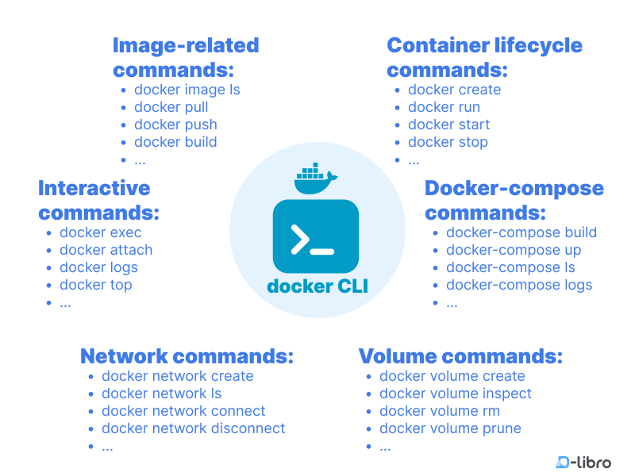
Docker commands
21

Slide 22
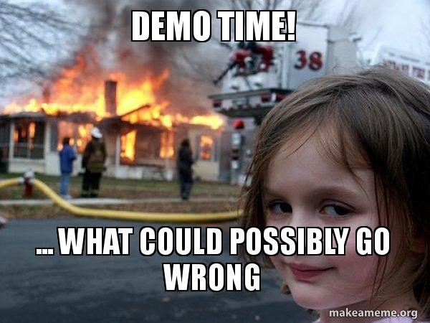
22

Slide 23
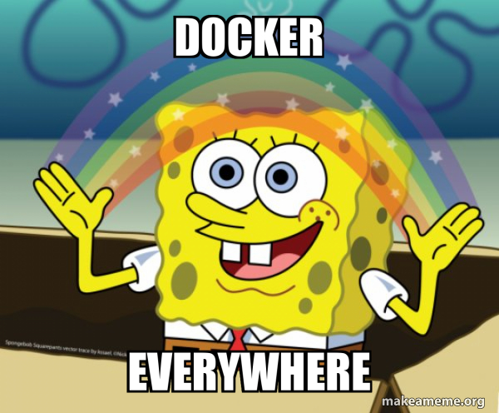
Docker Use Case
Continuous Integration/Continuous Deployment (CI/CD) pipelines
Microservices architectures
Development and testing environments
Cloud-native applications
Legacy application modernization
23

Slide 24

24

Slide 25

Thank you!!!
LinkedIn
25

